Slide 1

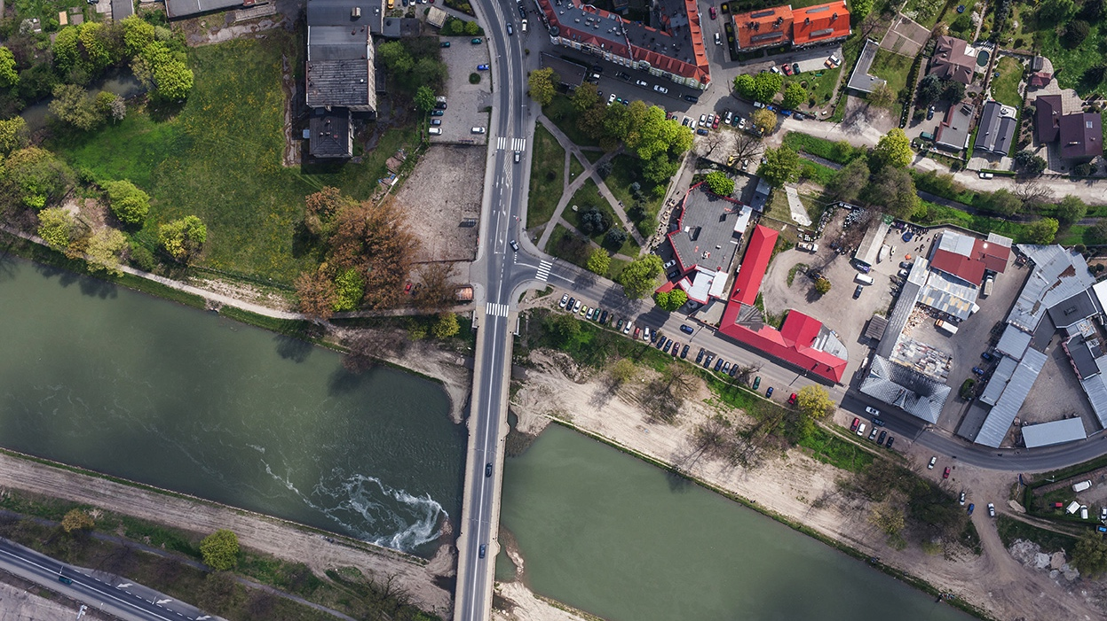
INFFEWS Overview
Dr Sayed Iftekhar
Project Leader, IRP2, CRC WSC
Department of Accounting, Finance and Economics,
Griffith University
https://watersensitivecities.org.au/content/project-irp2/

Slide 2
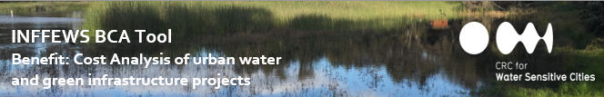
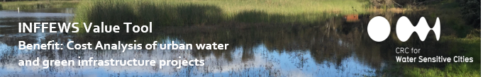
INFFEWS
Investment Framework For Economics of Water-Sensitive Cities
INFFEWS package:
BCA & Strategic Decision Making
BCA Tool
BCA Tool Guidelines
BCA Tool User Guide
BCA Comparison Tool
Rough BCA Tool
Value Tool
Value Tool Guidelines
Other Resources: training videos, case study reports, industry notes, user experience reports….

Slide 3
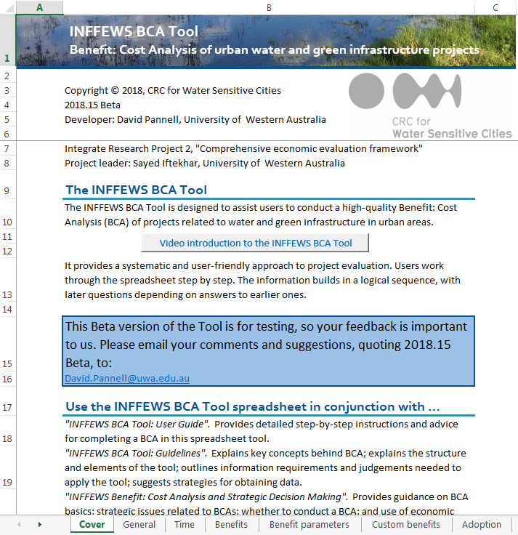
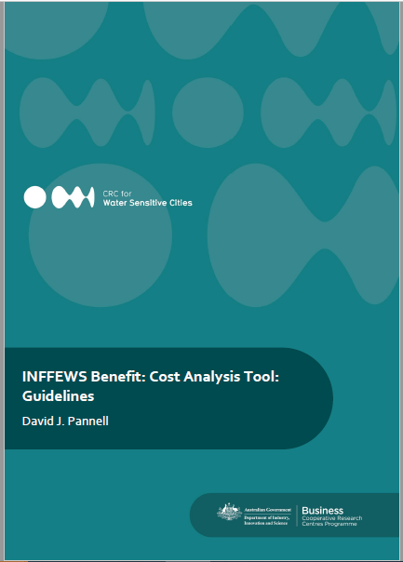
BCA Tool

Slide 4
BCA Tool
Assumptions (Discount rate, rate of adoption, risk, etc.)
Benefits (Physical changes, impacted area / population, future change)
Monetized benefits (Market / Nonmarket)
Overall BCR and NB (Efficiency)
Scenarios (With and Without Project)
Stakeholder level BCR and NB (Equity)
Analysis
Stakeholders (share of costs and benefits)
Activities (Physical input, current and future work)
Costs (capex, opex)
Sensitivity analysis (Robustness)

Slide 5

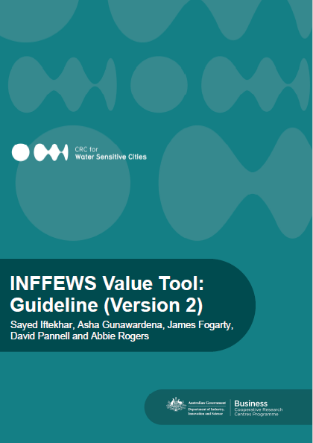
Value tool

Slide 6
Value tool
Focus on Australian studies
Information from 191 studies have been included so far
Total number of records: 2,368
Record with monetized information: 2,092
Record with non-monetized information: 276
Value functions: 10
Visualization of data
Information organized in an excel spreadsheet-based database

Slide 7

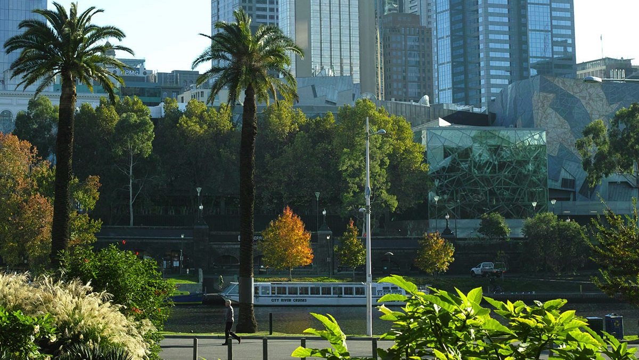
INFFEWS Adoption

Slide 8
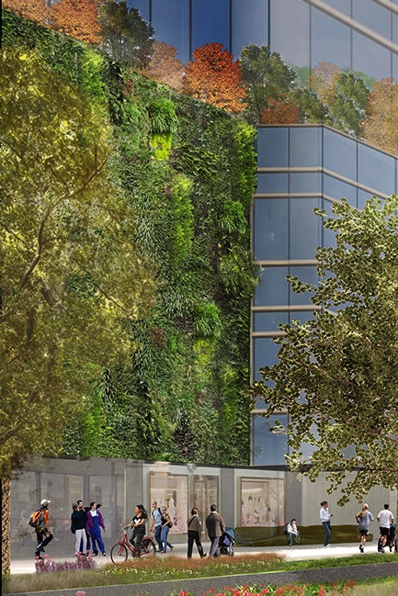
Adoption of the tools
The tools been independently reviewed by:
Metropolitan Investment and Evaluation Group (MIEG), Vic
NSW Treasury - NSW Public Sector Cost-Benefit Analysis Best Practice Group
SA Treasury
Melbourne Water Corporation (conducted by Marsden Jacobs & Associates)
NSW Department of Planning, Industry and Environment (DPIE)
Sydney Water (conducted by Aurecon Group)*
* In process

Slide 9

Adoption of the tools
They have been written into Guidelines:
NSW Department of Planning, Industry and Environment (coastal management CBA guidelines)
Blacktown City Council (tender submission guidelines)
Hunter Valley (tender submission guidelines)
City West Water (position description)
They have been informally recommended, including:
PEET suggested Marsden Jacobs for Brabham case study
MIEG informally recommended for case studies conducted by Yarra Valley Water, City West Water, & South East Water
DELWP is actively promoting for in-house economic analysis work.

Slide 10
Adoption of the tools
The tools have been applied by:
Brisbane City Council*
Townsville City Council*
Yarra Valley Water
Water Corporation of WA
WA Department of Water and Environment (DWER)
Advanced Choice Economics for World Bank China
Water Sensitive SA for City of Marion
E2Design for Moreland City Council
Wave Consulting for Blacktown City Council*
GHD for Hunter Valley
WSCI on Waterwise Queens Park Regional Open Space
NSW Department of Planning Industry and Environment (DPIE)
BDO EconSearch and Tonkin for the SA Department of Infrastructure and Transport
Urbaqua for City of Mandurah
Blacktown City Council
Wave Consulting for Blacktown City Council*
NCEconomics for Moreland City Council
* In process. With many more in the pipeline……

Slide 11
Shared with:
AECOM
Aither
Alluvium
Allwater
ARUP
ASPECT Studios
Aurecon Group
Australian National University
BDO EconSearch
BMT
Baron Water
Beca Group
Blacktown City Council
Bligh Tanner
Brisbane City Council
Building Queensland
Byron Bay Council
CSIRO
Central Coast Council
Central Queensland University
Charles Stuart University
City of Brimbank
City of Canning
City of Canterbury Bankstown
City of Gold Coast
City of Gosnells
City of Greater Dandenong
City of Joondalup
City of Mandurah
City of Melbourne
City of Melville
City of Nedlands
City of Perth
City of Port Philip
City of Salisbury
City of Sydney
City of West Torrens
City West Water
Coliban Water
Cooks River Alliance
Coolth Inc.
Curtin University
DBCA (WA)
DELWP (VIC)
DEWNR (SA)
DNRME (QLD)
DPIE (NSW)
DWER (WA)
Department of Communities (WA)
Department for Energy and Mining (SA)
Department of Defence (VIC)
Department of Environment and Science (QLD)
Department of Industry and Skills (SA)
Department of Premier and Cabinet (NSW)
Department of Transport (NSW)
DesignFlow
DevelopmentWA
Dja Dja Wurrung Enterprises
E2Designlab
EMRC
Economic Development Queensland
Edge Environment
Encader Consulting
Fairfield City Council

Slide 12
Shared with:
GHD
Greater Sydney Commission
Griffith University
HIP V. HYPE
Hornsby council
Hunter Water
Hydrology and Risk Consulting
Infrastructure Australia
International Water Centre Inner West City Council
Inside Infrastructure
IPART
Jacobs
KBR
Knox City Council
Ku-ring-gai Council
Lendlease WA
Logan City Council
Marsden Jacob Associates
Melbourne Water
Melton City Council
Monash University
Moonee Valley City Council
Murdoch University
NSW Treasury
Natural Capital Economics
Natural Decisions
OCULUS
Office of Environment and Heritage (NSW)
OptaMAX
Parks and Leisure Australia
Queensland Rural and Industry Development Authority
Queensland Urban Utilities
Queensland Water
Queensland Water Directorate
Rhelm
Rivelin Bridge
Rockhampton Regional Council
RMCG
SA Treasury
SA Water
SEQ Water
South East Water
Stantec
Stockland
Strategic Planning Institute
Sun Water
Sustain SA
Sustainable Living Products
Sydney Water
Synergies
Townsville City Council
Urbaqua
Unity Water
University of Adelaide
University of Melbourne
University of Queensland
University of SA
University of Technology Sydney
University of Western Australia
Wave Consulting
Water Corporation
Water Planning Services
Water Sensitive SA
Water Technology
Western Water
WSAA
Yarra Valley Water

Slide 13
INFFEWS
Investment Framework For Economics of Water-Sensitive Cities
For training and support services in INFFEWS, CRCWSC recommends engaging:
Advanced Choice Economics
Contact: Dr Elizabeth Petersen (Liz), Director & Principal Applied Economist
Phone: +61 (0)8 9332 8310 or +61 (0)404 077 194
Email: Liz.Petersen@tpg.com.au
GHD
Contact: Ryan Brotchie, GHD Associate, Integrated Water Management
Phone: +61 (0)3 8687 8827 or +61 (0)439 637 520
Email: ryan.brotchie@ghd.com
Natural Decisions
Contact: Dr Anna Roberts, Director
Phone: 61 (0)437 887 485
Email: anna.roberts@naturaldecisions.com.au
E2Designlab
Contact: Celeste Morgan Senior Associate Sustainability Strategist
Phone: +61 (0)3 9654 7274 or +61 (0)428 499 577
Email: celeste@e2designlab.com.au
NCEconomics
Contact: Buyani Thomy, Environmental and Resource Economist
Phone: +61 (0)401 625 281
Email: buyani.thomy@nceconomics.com
Water Technology
Contact: Michael Di Matteo, Environmental Engineer
Phone: +61 (0)8 8378 8000 or +61 (0)403 974 113
Email: michael.dimatteo@watertech.com.au

Slide 14

Follow us on Twitter
@CRCWSC
Follow us on YouTube
/WaterSensitiveCities
Thank you.

