Slide 1
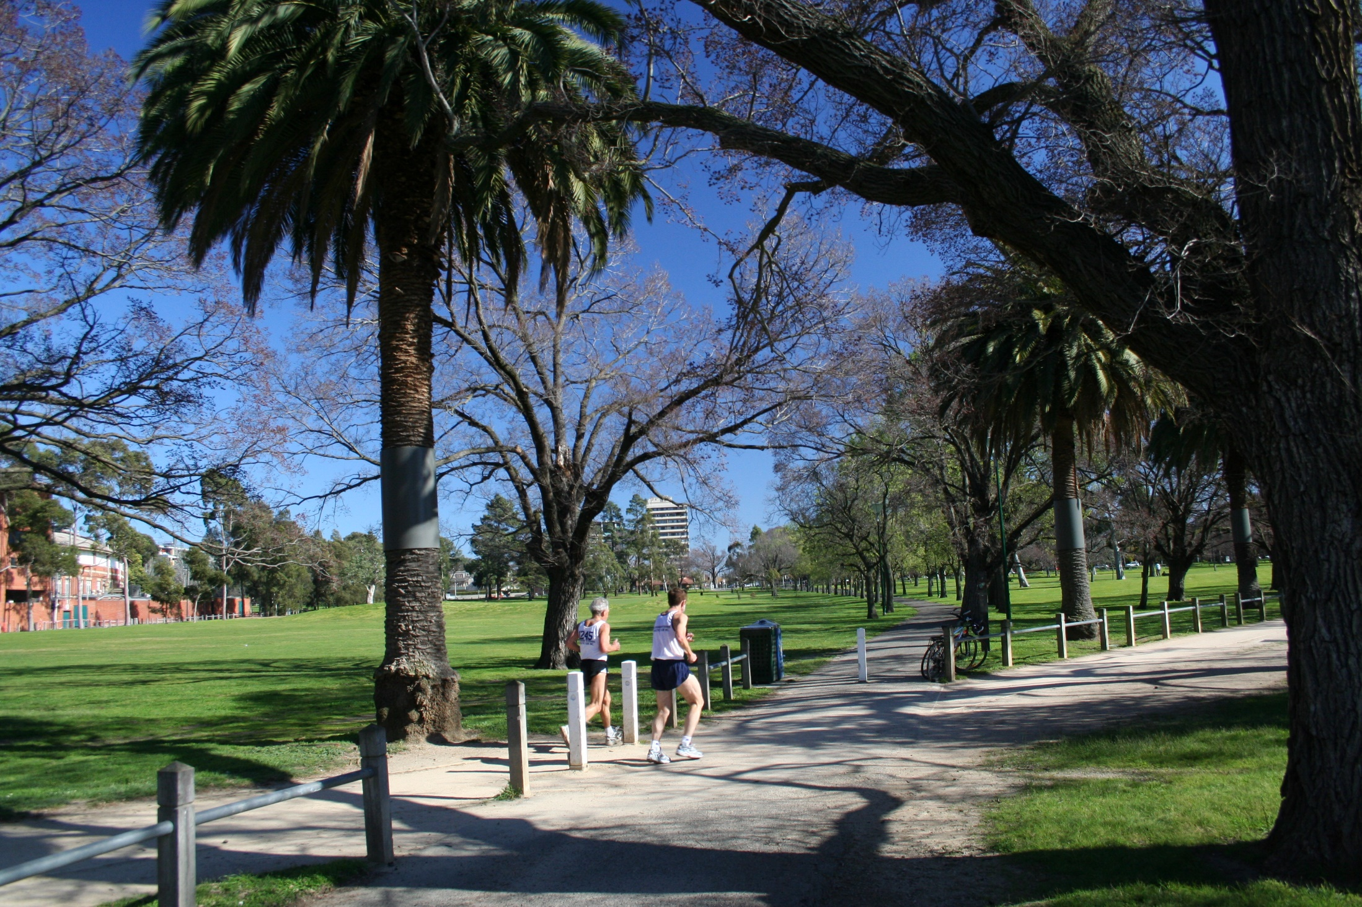
Industry application of INFFEWS Stormwater harvesting to support Princes Park
Celeste Morgan, E2Designlab

Slide 2
Agenda
The project and why an economic assessment was needed
Developing a business case in a nutshell
Step-by-step business case development and results
Reflections and lessons learned

Slide 3
The proposal: Stormwater harvesting to replace potable irrigation of Princes Park and local trees
City of Melbourne conducted concept level investigations
Not yet detailed enough for a detailed economic appraisal
Needed to test the case to see if it was worth taking to detailed design.

Slide 4
Dilemma: Is this too early to do a full economic assessment?

Slide 5
INFFEWS was chosen to de-code the ‘dark-art’ of economics to provide an insightful business case at an early stage
Important to also make the summary BCA document short and approachable

Slide 6
In a nutshell: A preliminary business case approach using INFFEWS
Step 1: Review of project proposal and stakeholder interview
Step 2: Initial identification of potential benefits using Values tool
Step 3: Stakeholder workshop
Step 4: Conduct BCA and create a
4-page business case summary

Slide 7
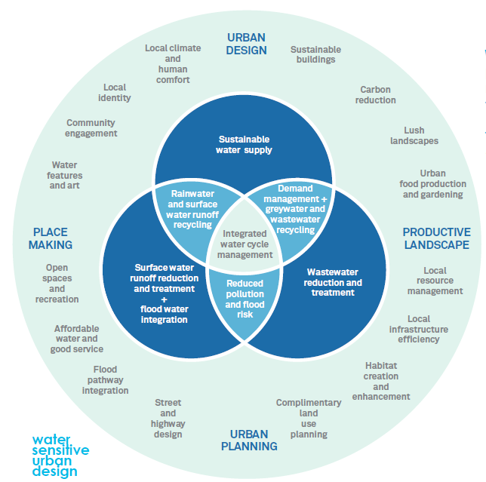
Step 1: Review of project proposal and stakeholder interview
City of Melbourne were keen to evaluate the project holistically.
Commonly, stormwater harvesting schemes are assessed using financial assessment, looking at directly quantifiable benefits to council.
This neglects broader social and environmental benefits to local communities.
Through a holistic economic assessment some of these benefits can be monetized based on research. Values observed elsewhere can be utilized by using a benefit transfer method.
Notes:
The INFFEWS Benefit-Cost Analysis Tool (hereby referred to as the ‘BCA tool’) is an excel-based
framework that allows the user to develop a benefit-cost analysis. It has been developed in response
to feedback from industry who highlighted that the development of a holistic business case was an
important factor in the delivery of water sensitive investments. Accordingly, the BCA tool is tailored
specifically to assessing investments for water-sensitive cities. Its contents, framework and
assumptions are based on sound economics and the tool is fully consistent with guidelines prepared
by Australian state and national governments.
Business cases are important tools used in decision making, assessing options in a transparent
manner which gives stakeholders confidence when investing. Benefit: Cost Analysis (BCA) is widely
used tool to support the development of business cases, by measuring the benefits against the costs
to determine if a project is worthwhile.
Water sensitive investments typically result in vegetated built assets (otherwise known as green
infrastructure) which are deliver a wider range of environmental and social values than perhaps
traditional water infrastructure (such as underground pipes and industrial buildings) might. It was
recognised by partners of the CRC for Water Sensitive Cities, including state government agencies,
local governments and water utilities, that an increased capacity for economic analysis that
recognised these broader benefits was a high priority to allow effective business cases to be
developed for water sensitive investments.

Slide 8
Framing future scenarios
A stormwater harvesting scheme will provide a new water source and improve waterway health.
However, it may also add resilience and provide additional benefits during drought periods.
The Millennium drought resulted in water restrictions for 6 years between 2002-2008. Since then, the desalination plant has added resilience to the potable water system.
This analysis examines a scenario where a similar drought would occur in 2032, and water restrictions would be in place.

Slide 9
Scenarios
SCENARIOS | Scenario 1 – No drought | Scenario 2 – During drought
 | 2021-2031 2039-2070 | 2032-2038
Without Project | Irrigation of Princes Park and street trees with potable water | Highly reduced irrigation of parks and street trees
Performance | 100% of current demand met | Recycled water is trucked in to provide 30% of tree demand and 7.5% of open space demand
With Project | Irrigation of Princes Park and street trees with stormwater and potable top-up | Irrigation of Princes Park and street trees with stormwater only
Performance | 100% of current demand met (with reduced potable use) | 77% of current demand met by stormwater

Slide 10
Step 2: Initial identification of potential benefits using Values tool
Potable water savings
Avoided pre-mature death of trees
Reduction in stormwater pollutants reaching Port Phillip Bay
Avoided cost of trucked water during drought
Maintained recreation and amenity during drought
Avoided sports safety ground checks during drought
Maintained cooling benefit during drought

Slide 11
Step 3: Stakeholder workshop
 |  | Scenario 1 – No drought |  | Scenario 2 – During drought
 |  | Without | With | Without | With
Amenity and recreation
Community willingness to pay for recreation and amenity | Multiplier Population using fields and Royal Parade
Benefit transfer value: $56.60 ($2017)
From: Research Paper - Valuing environmental services provided by local stormwater management (Brent et al, 2017)
Location: Moonee Valley and Manningham
Summary:
Baseline: Under the status quo, local sports grounds, parks and street line vegetation are not watered and will appear brown or may die during dry summers.
Level 2: Irrigation to ensure that local parks and sports grounds are green all year round and that mature trees on residential streets are not lost during periods of drought.
2 surveys:
2013: 981 householders were interviewed about their willingness to pay for the benefits from local stormwater management.
Late 2014: resampling 318 of the wave 1 households using an identical survey instrument.
Notes:
The INFFEWS Benefit-Cost Analysis Tool (hereby referred to as the ‘BCA tool’) is an excel-based
framework that allows the user to develop a benefit-cost analysis. It has been developed in response
to feedback from industry who highlighted that the development of a holistic business case was an
important factor in the delivery of water sensitive investments. Accordingly, the BCA tool is tailored
specifically to assessing investments for water-sensitive cities. Its contents, framework and
assumptions are based on sound economics and the tool is fully consistent with guidelines prepared
by Australian state and national governments.
Business cases are important tools used in decision making, assessing options in a transparent
manner which gives stakeholders confidence when investing. Benefit: Cost Analysis (BCA) is widely
used tool to support the development of business cases, by measuring the benefits against the costs
to determine if a project is worthwhile.
Water sensitive investments typically result in vegetated built assets (otherwise known as green
infrastructure) which are deliver a wider range of environmental and social values than perhaps
traditional water infrastructure (such as underground pipes and industrial buildings) might. It was
recognised by partners of the CRC for Water Sensitive Cities, including state government agencies,
local governments and water utilities, that an increased capacity for economic analysis that
recognised these broader benefits was a high priority to allow effective business cases to be
developed for water sensitive investments.

Slide 12
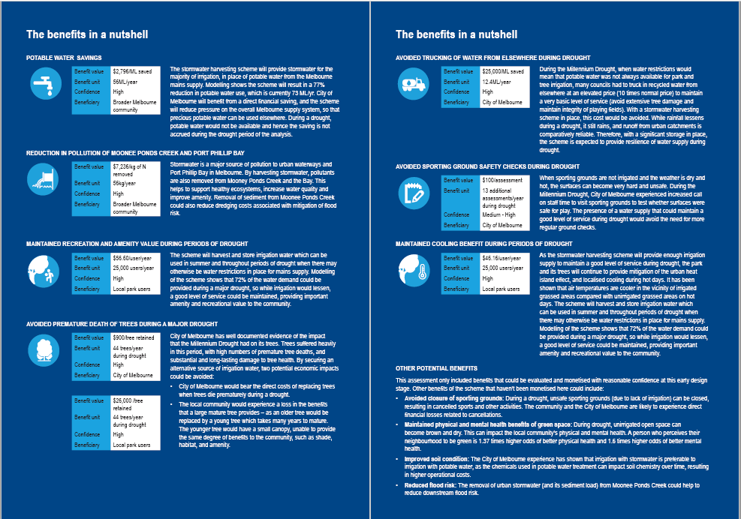
Step 4: Conduct BCA and create a
4-page business case summary

Slide 14
Reflection: Tailor presentation to purpose
INFFEWS provided a simple platform for a non-economist practitioner to use, but it was important to then take the results and present in a simple summary for a general audience.
Values were extracted from the tool to create graphs and infographics.
This was used by council to make the case for further investment into project development.

Slide 15
Reflection: Make it robust yet simple
It was important to talk through all of the analysis assumptions and ‘with and without’ scenarios with stakeholders to ensure benefits are valid and there is no double counting.
Final business case included sensitivity analysis from INFFEWS and all assumptions, but not ‘weighed down’ by details.

Slide 16
Reflection: Recognise not everything can be monetised
While we tried to include benefits as much as possible, it was important to highlight other benefits that couldn’t be monetised.

