Slide 1
CRCWSC INFFEWS Benefit: Cost Analysis Tool
INFFEWS WEBINAR
Application to Mandurah MAR project
Alex Towler

Slide 2
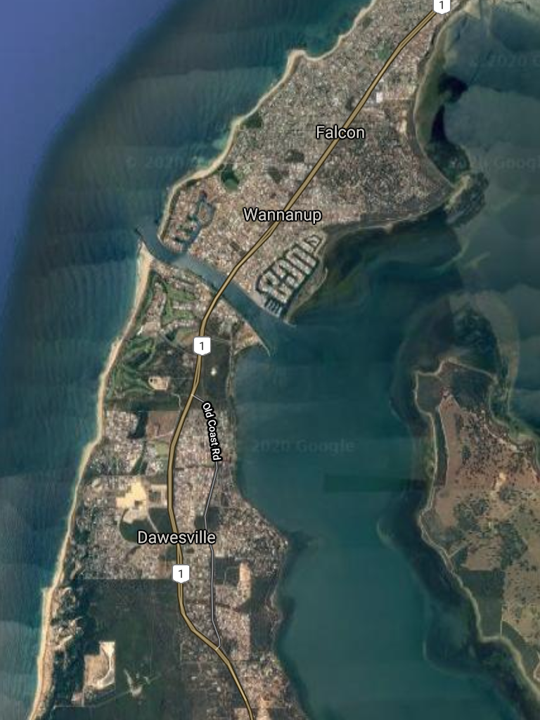
The project
City of Mandurah
Approx. 70 km south of Perth
Between 2006 and 2011 the population increased by 70%
No active reserve south of the Dawesville Channel
Dawesville Channel

Slide 3
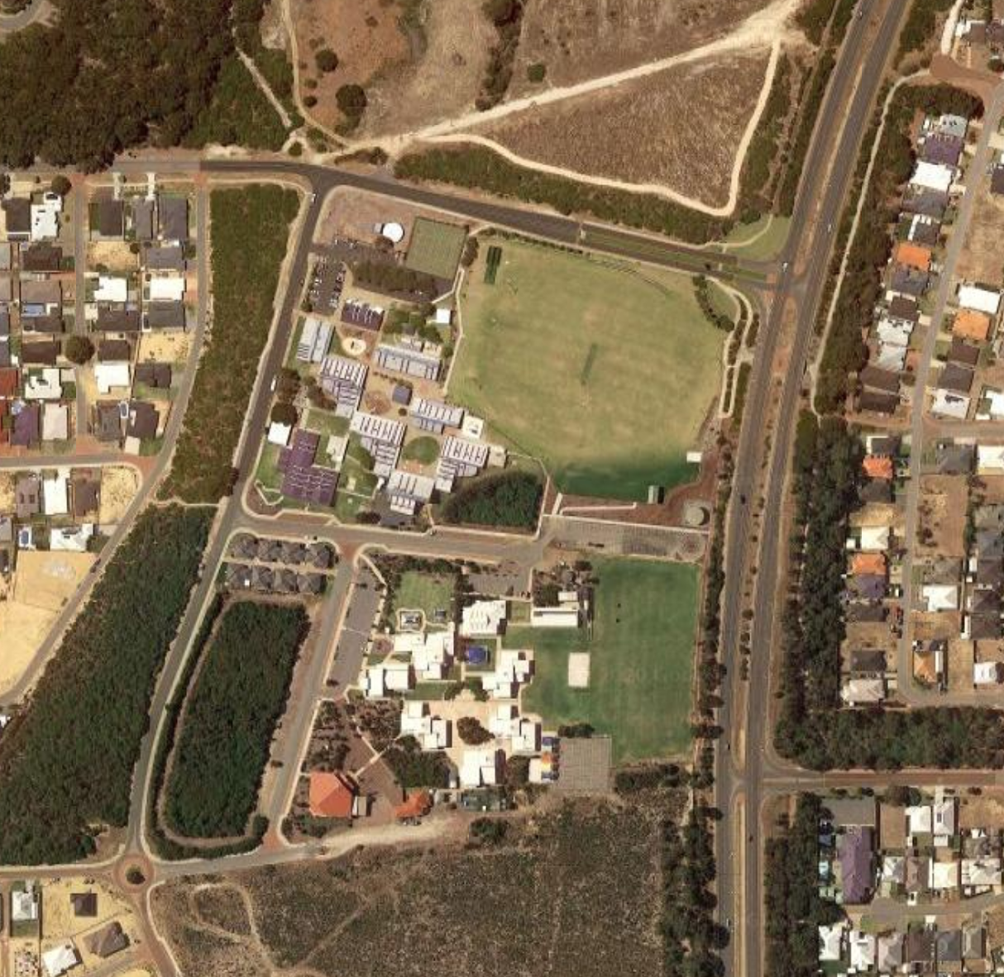
The project
Ocean Rd Oval
Adjacent to Ocean Road Primary
Area of unused land identified for conversion to active open space
Provide residents south of the Dawesville Channel with dedicated POS for sporting and recreation opportunities
Ocean Road Primary
St. Damian’s Catholic Primary

Slide 4
Finding a water source
Scarcity of water was a limiting factor in the project
Options investigated
Scheme water
Groundwater
Desalination
Wastewater re-use
Synthetic turf

Slide 5
Assumptions
The initial capital costs are covered by Royalties for Regions
All ongoing operational costs are covered by the City of Mandurah
Water requirements:
Establishing year – 30,000-42,000 kL
Ongoing – 24,000-37,000/year
St Damian’s Primary School will not contribute under scenarios 1 & 2

Slide 6
Without-project scenario
Development goes ahead with scheme water as the water source
$2.20 kL (estimated for the purpose of the BCA)

Slide 7
With-project scenario #1 – Dedicated desalination plant
Costs | Benefits
Capital costs (CoM) - $750,000 - $900,000 for acquisition of land and construction of the plant Capital costs (Western Power) - $100,000 | Sustainable source of water (non-market value) Avoidance of scheme water during establishment - 42,000 kL for establishing year = $92,400
Operating costs - $102,000 per annum: Removal of waste products, power costs, maintenance of plant and disposal of saline brine waste product | Avoidance of scheme water costs for 37,000 kL per annum = $81,400/annum

Slide 8
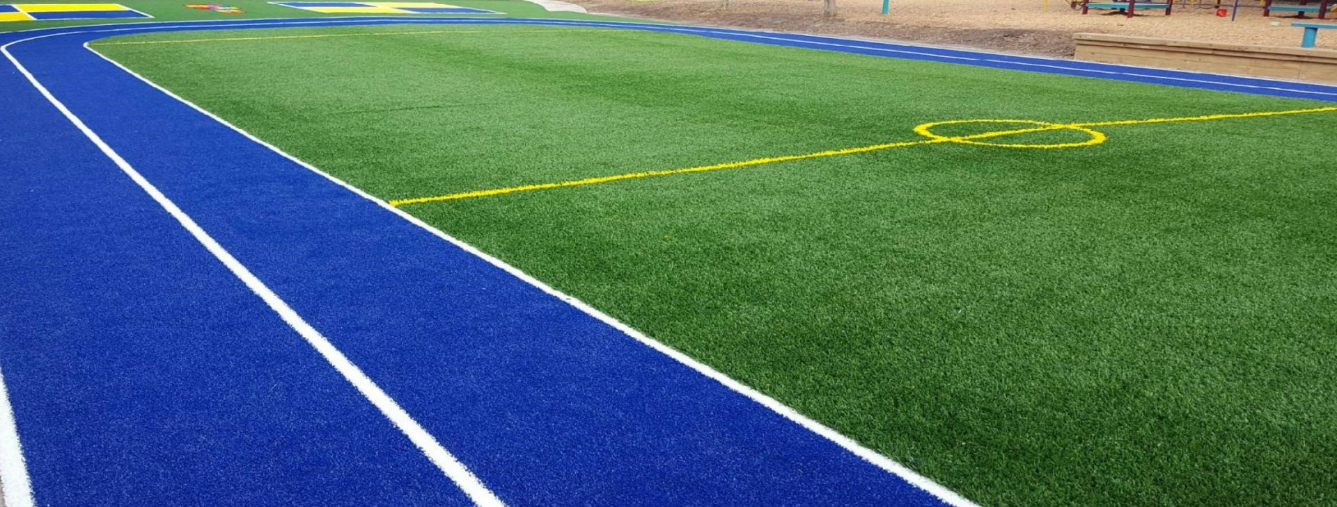
With-project scenario #2 – Synthetic turf
Costs | Benefits
Capital costs (CoM) - $1,500,000 | Significantly lower water usage
Operating costs (CoM) - $220,000 per annum. Full replacement every 6-8 years = ~$210,000 per annum plus scheme water to cool before use = ~$10,000/annum | Avoid scheme water cost of approx. 34,000 kL per annum = $71,400/annum

Slide 9
With-project scenario #3 – Caddadup managed aquifer recharge (MAR)
Costs | Benefits
Feasibility study (CoM) - $28,000 for monitoring, lab fees, modelling Capital cost (CoM) - $655,000 for bore installation, storage tank installation and pipe system to oval | Sustainable source of water (non-market value) Avoidance of scheme water during establishment estimated at 42,000 kL for establishing year = $92,400
Operating cost (CoM) - $25,500 for power for pumping, land lease fee and water quality monitoring | Avoidance of scheme water - 37,000 kL per annum = $81,400/annum

Slide 10
BCA results
 | BCR | NPV
Scenario 1 – Desalination
Overall | -0.57 | - $2,336,290
Project organisation | 0.26 | - $1,103,559
Scenario 2 – Synthetic turf
Overall | -0.54 | -$3,816,670
Project organisation | 0.13 | -$2,158,466
Scenario 3 - MAR
Overall | -0.02 | -$311,157
Project organisation | 1.81 | $247,575

Slide 11
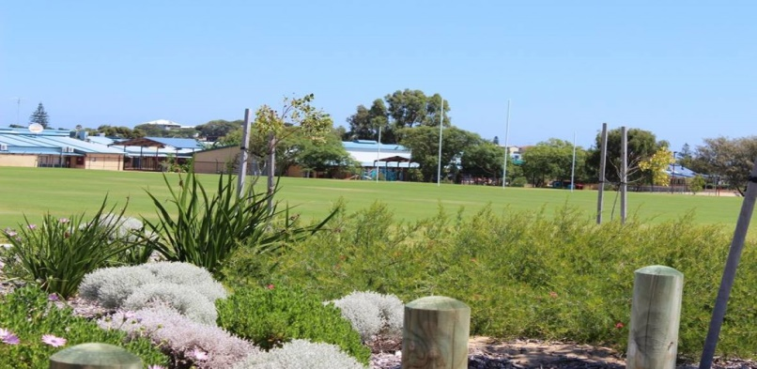
Questions?

