Slide 1
<< logo >>
<< logo >>
<< logo >>
Water Sensitive Cities Index Benchmarking
Workshop

Slide 2
Why do we need water sensitive cities?
To meet three challenges that critically affect cities and towns in Australia and across the world:
population growth and changes in lifestyle and values;
climate change and climatic variability; and
challenging economic conditions.
Notes:
Cities around the world are realising the fundamental importance of managing water resources and water systems services to enhance the liveability, productivity and resilience of cities. These benefits are captured in the concept of the water sensitive city, a term that originated in Australia and has diffused around the world and now defines the highest level of performance and achievement in urban water management.

Slide 3
What is the CRC for Water Sensitive Cities?
The CRCWSC is an Australian research centre that brings together many disciplines, world-renowned subject matter experts, and industry thought leaders who want to revolutionise urban water management in Australia and overseas.
The CRCWSC is an Australian research centre that brings together many disciplines, world-renowned subject matter experts, and industry thought leaders who want to revolutionise urban water management in Australia and overseas.
Notes:
The Cooperative Research Centre for Water Sensitive Cities (CRCWSC) has developed a Water Sensitive Cities (WSC) Index that offers users the ability to benchmark cities (at the metropolitan or municipal scale), based on performance against a range of urban water indicators that characterise the water sensitive city.

Slide 5
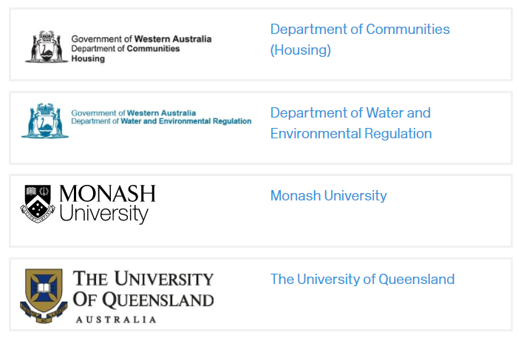
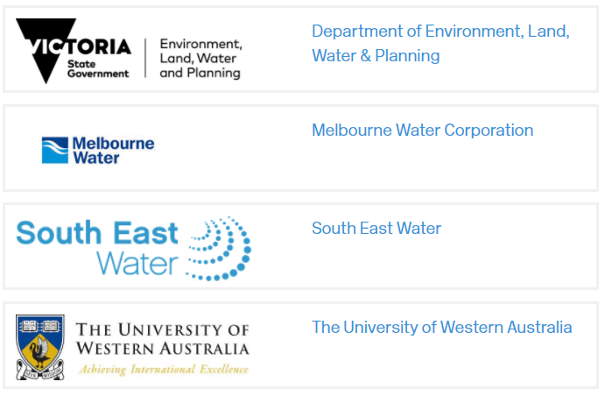
CRCWSC essential participants

Slide 7
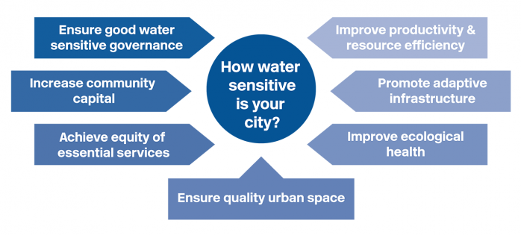
What it measures – Urban water indicators
Notes:
What is the WSC Index?
A tool to enable decision makers to lead change. It includes seven goals covering governance, community capital, equity, productivity and efficiency. Infrastructure, ecology and urban design.
The Index has been developed from of a significant history of investment in multidisciplinary research and two years of testing and validation with industry partners to ensure a useful product that is functional, reliable and scientifically robust.
The beta Version of the Index was released in September 2016. Further industry validation of the Index occurred during 2017, with over 20 cities and councils around Australia and internationally being benchmarked.. Version 1.1 of the WSC Index was finalised in early 2018.

Slide 8
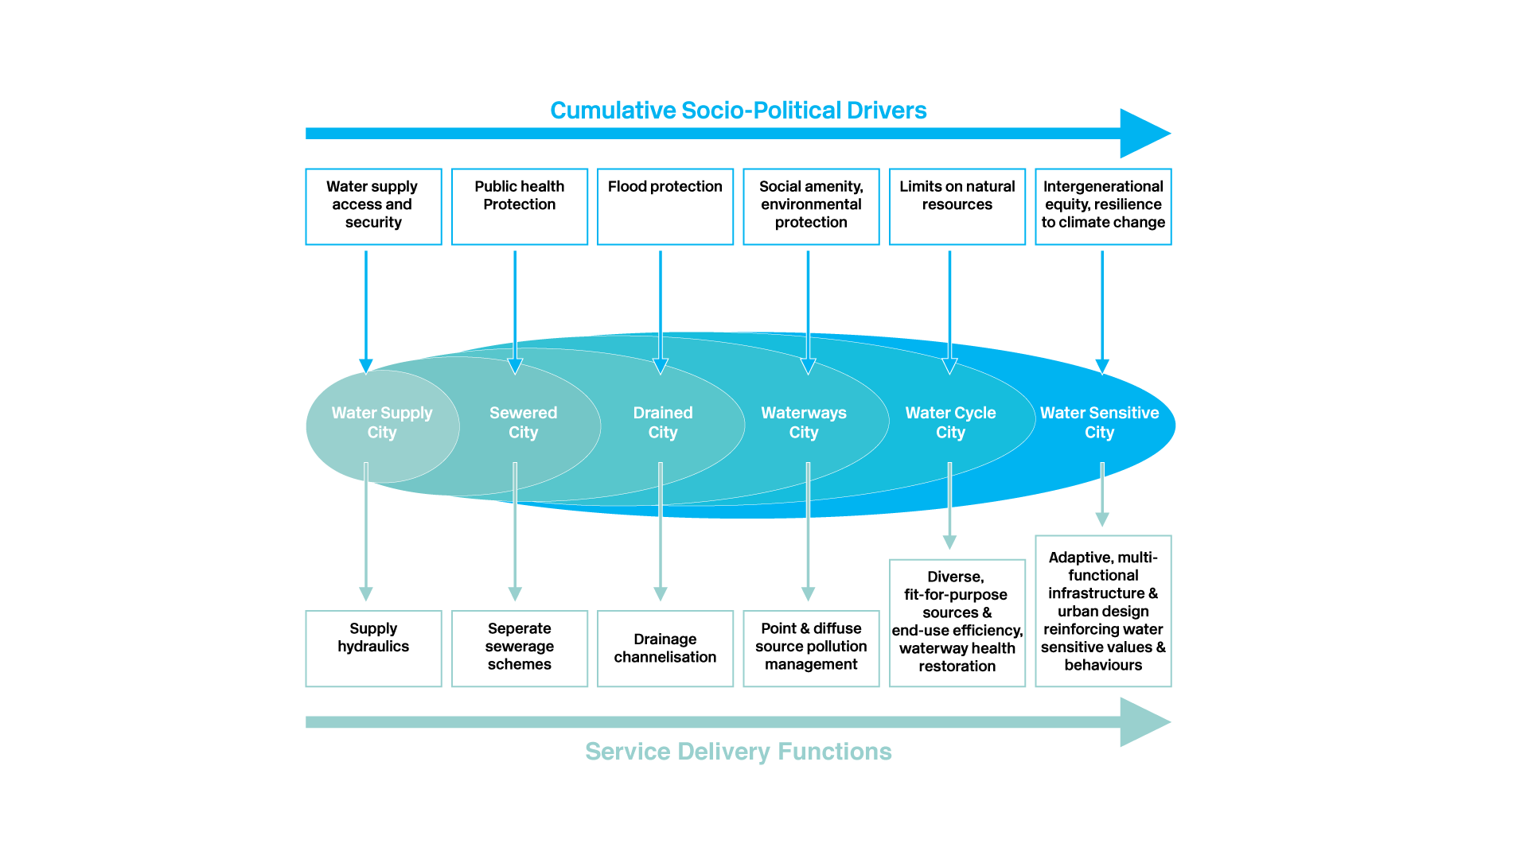
Urban water transition phases
Notes:
Indicator scores are translated into several measures of city status to assist cities to understand their progress towards greater water sensitivity. The water sensitive city continuum represents a city’s progress through a number of historical phases of infrastructure and institutional development. (insert continuum).
The ‘City State Continuum’ describes a number of ‘city states’ that represent the ways a city may evolve its water system services as it grows and develops over time. It is derived from urban water research at Monash University that looked at the historical provision of water services in developed cities over time. Melbourne was the initial focus of that research.
Early in a city’s life, securing a safe and reliable water supply will be a priority. As the population grows, sanitation services need to provide a means of collecting and treating or disposing of waste to prevent the spread of disease. Drainage and flooding may become a constraint to growth and require increased investment in drainage infrastructure. Water supply, sewerage and drainage represent the three core water system services that tend to dominate water service provision in cities around the world.
Generally, these services are provided by large public utilities operating large-scale, centralised infrastructure (dams, sewerage treatment plants, large pipelines).
Many cities reach a point where the cumulative impacts of this form of servicing the city, has impacts on the environment that an increasingly prosperous and educated community seeks to change. Waterways are valued for their environmental and amenity values. Pollution from sewage and stormwater will become increasingly regulated and investment will support greater community use of waterways. This is the ‘Waterways City State’.
Limits on natural resources, such as catchments where more dams can be built, environments not able to assimilate the disposal of wastewater without impacts that have become unacceptable to the community, will begin to drive change represented by the ‘Water Cycle City’ state. Recycling and resource recovery will be a priority. Technologies become more advanced. Systems are increasingly decentralised and levels of service more focussed on user needs.
New institutions emerge and existing institutions must become more flexible. There is greater scope for private sector providers and community participation in service provision.
Finally, the ‘Water Sensitive City’ state in a hypothetical future ‘city state’, where water system services are optimised to enhance the liveability, sustainability, productivity and resilience of the city. It is characterised by adaptive, multi-functional infrastructure and urban design that operated as part of the water system. Citizens are involved in planning and decision making and can participate in service delivery individually and collectively. Large scale, centralised infrastructure is integrated with small scale, decentralised infrastructure.

Slide 9
Exclusive large-scale centralised infrastructure and institutions
Flexible, integrated, complex infrastructure and institutions
Adaptability,
Flexibility,
Resilience &
Reflexivity

Slide 10
The water insensitive city…
Water Supply
Centralised
Large dams
Desalination
Sewerage
Centralised
Disposal
Drainage
Hydraulically efficient (roof to waterway)
Flash rain response
Urban Stream Syndrome
Notes:
Indicator scores are translated into several measures of city status to assist cities to understand their progress towards greater water sensitivity. The water sensitive city continuum represents a city’s progress through a number of historical phases of infrastructure and institutional development. (insert continuum).
The ‘City State Continuum’ describes a number of ‘city states’ that represent the ways a city may evolve its water system services as it grows and develops over time. It is derived from urban water research at Monash University that looked at the historical provision of water services in developed cities over time. Melbourne was the initial focus of that research.
Early in a city’s life, securing a safe and reliable water supply will be a priority. As the population grows, sanitation services need to provide a means of collecting and treating or disposing of waste to prevent the spread of disease. Drainage and flooding may become a constraint to growth and require increased investment in drainage infrastructure. Water supply, sewerage and drainage represent the three core water system services that tend to dominate water service provision in cities around the world.
Generally, these services are provided by large public utilities operating large-scale, centralised infrastructure (dams, sewerage treatment plants, large pipelines).
Many cities reach a point where the cumulative impacts of this form of servicing the city, has impacts on the environment that an increasingly prosperous and educated community seeks to change. Waterways are valued for their environmental and amenity values. Pollution from sewage and stormwater will become increasingly regulated and investment will support greater community use of waterways. This is the ‘Waterways City State’.
Limits on natural resources, such as catchments where more dams can be built, environments not able to assimilate the disposal of wastewater without impacts that have become unacceptable to the community, will begin to drive change represented by the ‘Water Cycle City’ state. Recycling and resource recovery will be a priority. Technologies become more advanced. Systems are increasingly decentralised and levels of service more focussed on user needs.
New institutions emerge and existing institutions must become more flexible. There is greater scope for private sector providers and community participation in service provision.
Finally, the ‘Water Sensitive City’ state in a hypothetical future ‘city state’, where water system services are optimised to enhance the liveability, sustainability, productivity and resilience of the city. It is characterised by adaptive, multi-functional infrastructure and urban design that operated as part of the water system. Citizens are involved in planning and decision making and can participate in service delivery individually and collectively. Large scale, centralised infrastructure is integrated with small scale, decentralised infrastructure.

Slide 11
Exclusive large-scale centralised infrastructure and institutions
Flexible, integrated, complex infrastructure and institutions
Adaptability,
Flexibility,
Resilience &
Reflexivity

Slide 12
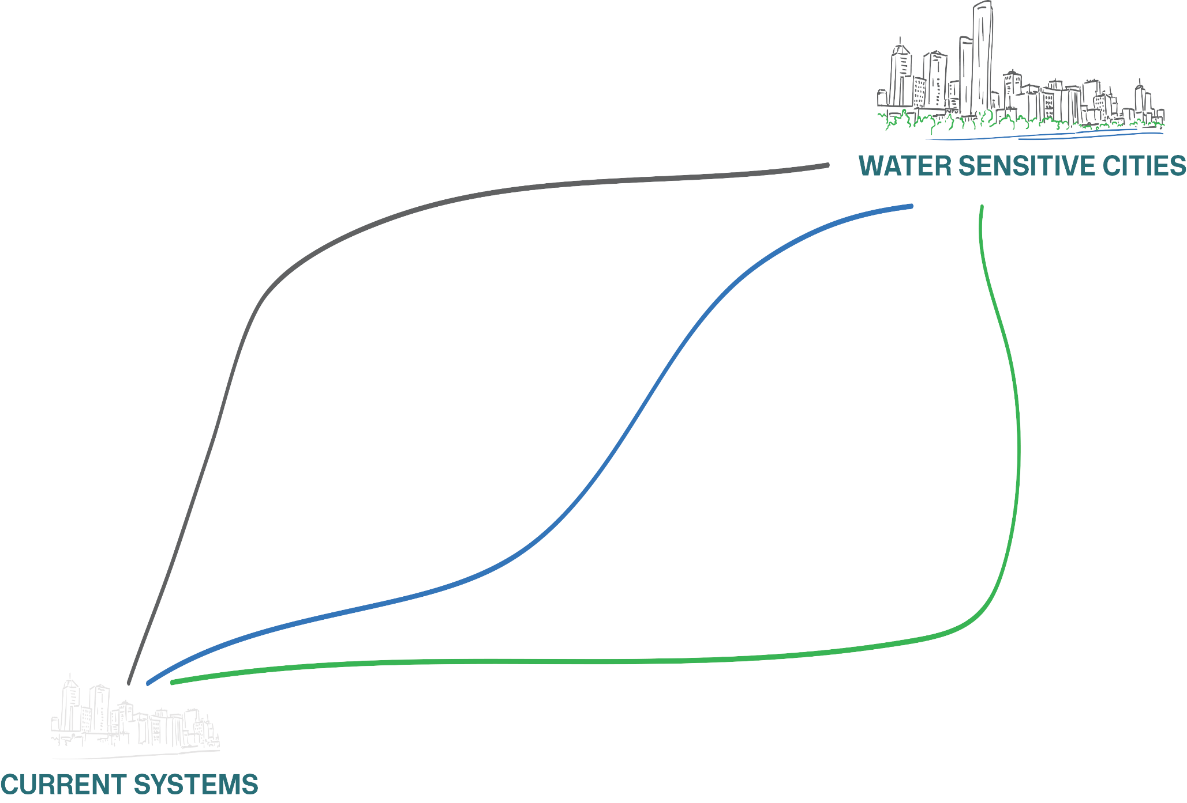
Urban water transitions
Notes:
Much of the CRC’s research is focussed on how to accelerate the transition through city states to the water sensitive city. The WSC Index is designed to benchmark cities against a range of WSC indicators and to help cities to set targets and develop management actions to advance their water sensitive practices.

Slide 13
Water sensitive outcomes
LIVEABLE
RESILIENT
SUSTAINABLE
PRODUCTIVE
Notes:
Measures of sustainability, liveability, resilience and productivity, help a city represent the degree to which water system services are directly contributing to these outcomes. The extent of practices such as managing cities as catchments, delivering ecosystem services and encouraging water sensitive citizens are also represented in the results.

Slide 14
Pillars of water sensitive practice
Cities as water supply catchments
Cities providing ecosystem services
Cities comprising water sensitive communities
Notes:
Talk to this slide for this point – no additional slides

Slide 15
What is the purpose
of the Index?
What does the Index do?
Provides
diagnostic insight to support action for
water sensitive city transitions
To benchmark current water sensitive performance of a place
To help city stakeholders articulate a shared set of water sensitive aspirations
Fosters
industry collaboration
Helps set targets and track progress
Notes:
The WSC Index is one of a number of CRCWSC tools to help cities transition to a more water sensitive future.
It draws on cross-organisational knowledge sharing and collaboration that will strengthen industry relationships with progress toward a shared vision. Breaking down organisational and institutional silos and opening up communication channels are some of benefits that come with using the WSC Index Tool.
Many cities are now using the web-based Index tool to identify gaps and set targets to accelerate their transition progress. Targets can be set for overall water sensitivity using the city continuum or for individual goal and indicator scores. The impact of actions can be modelled by manipulating indicator scores and re-running the Index tool to show results. This planning functionality in the tool is being further developed in a major project with a number of case study cities currently underway.

Slide 16
Index development process
Development and testing (Oct 2014 – Sep 2016)
Literature review
Framework development
Prototype testing
Framework refinement
Pilot testing
beta version released
Validation and refinement
(Oct 2016 – Dec 2017)
International testing
CRCWSC IRP1 WSC Visions and Transition Strategies
Industry validation
Roll out and further development
(Jan 2018 +)
Public release
International applications
Further development
Integration into Transitions Platform
Notes:
The Index has been developed from of a significant history of investment in multidisciplinary research and two years of testing and validation with industry partners to ensure a useful product that is functional, reliable and scientifically robust.
The beta Version of the Index was released in September 2016. Further industry validation of the Index occurred during 2017, with over 20 cities and councils around Australia and internationally being benchmarked.. Version 1.1 of the WSC Index was finalised in early 2018

Slide 17
Spare slide if required

Slide 18
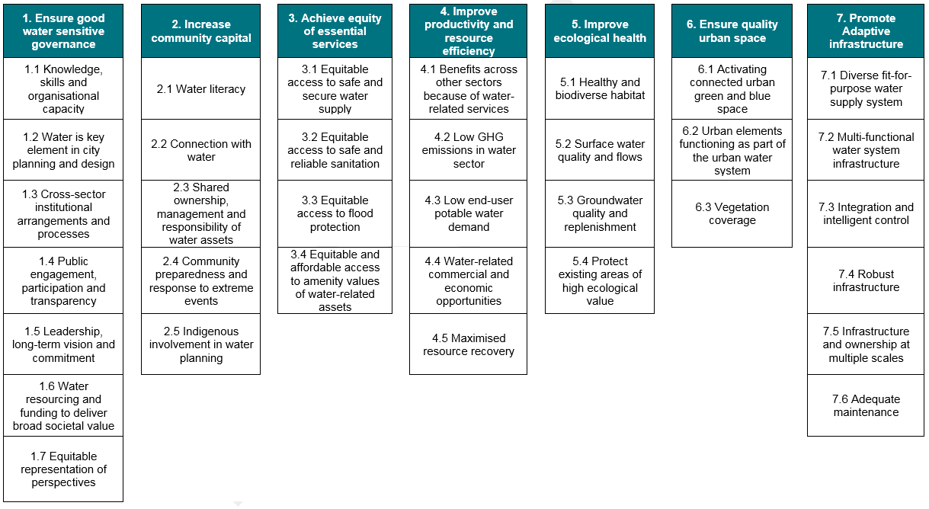
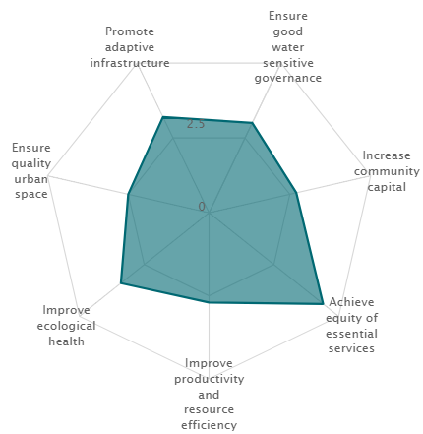
The WSC Index: 7 Goals, 34 indicators
Notes:
Note 34 indicators covering biophysical and socio-institutional factors.

Slide 19
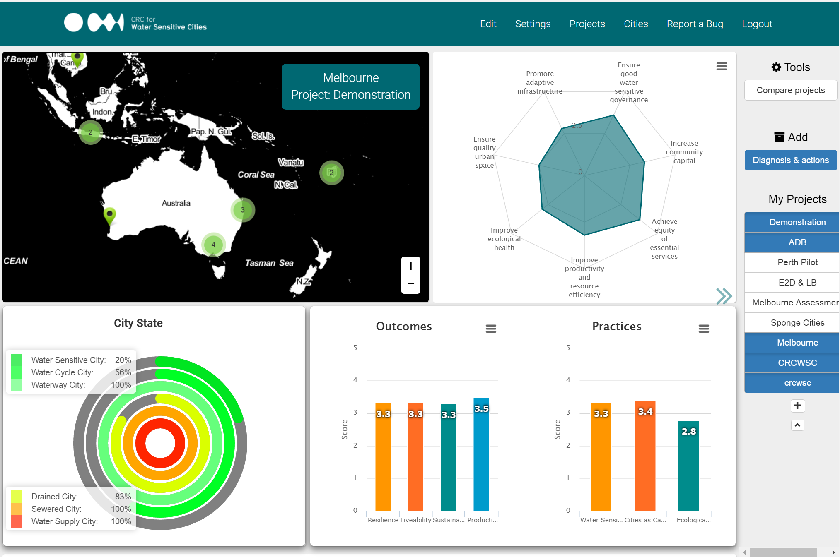
Notes:
Dashboard of results. Briefly describe.

Slide 20
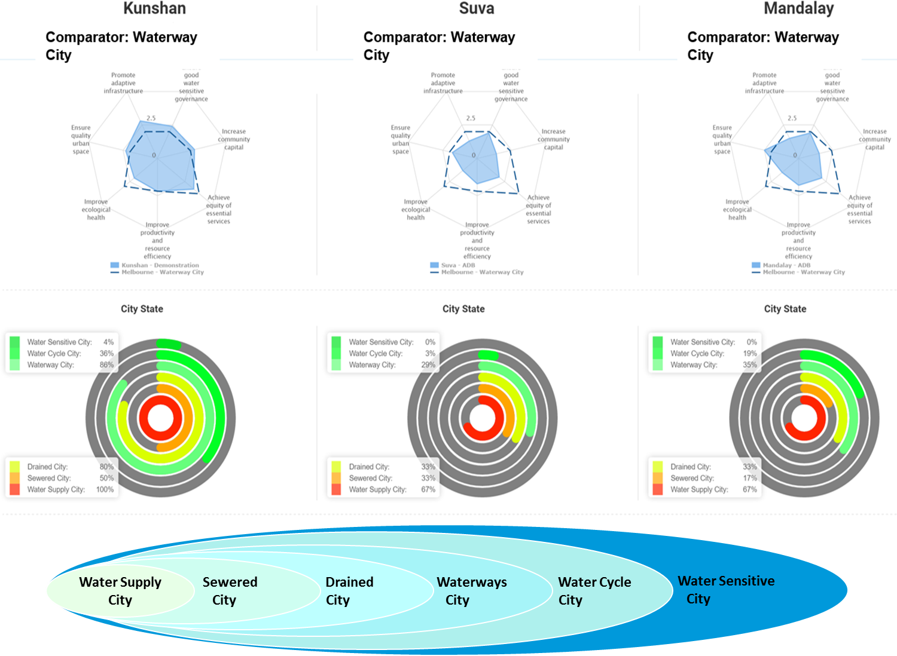

Slide 21
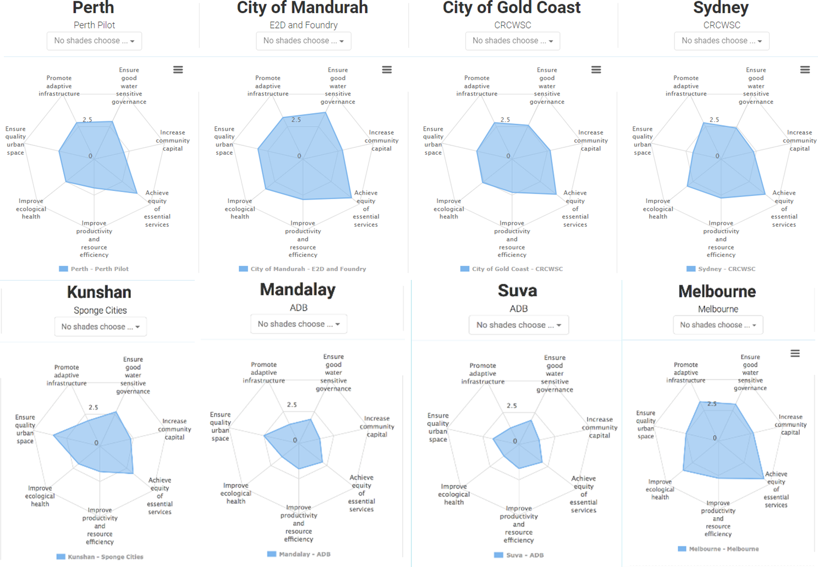

Slide 22
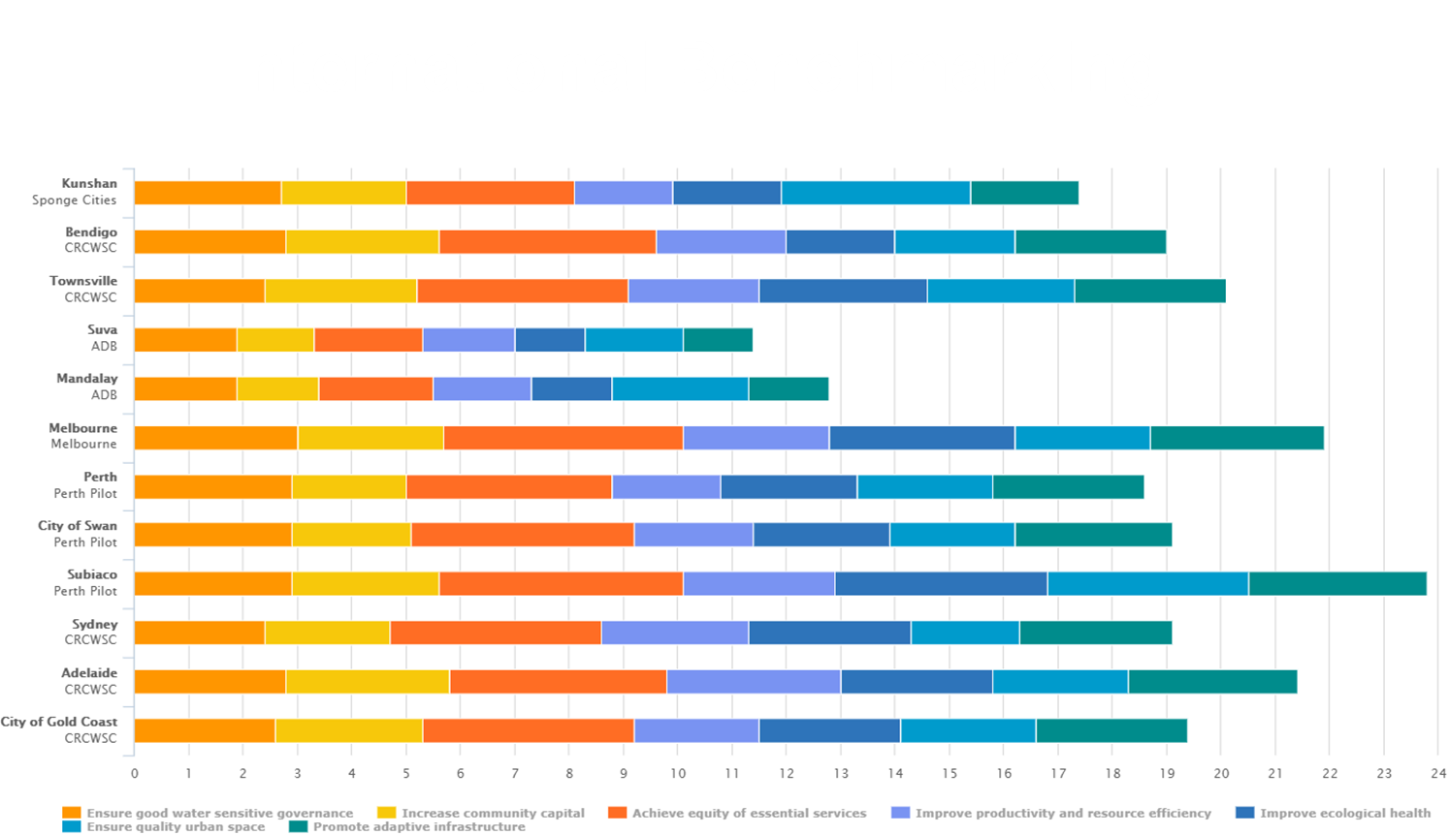
International benchmarking
Notes:
Note 34 indicators covering biophysical and socio-institutional factors.

Slide 23
Pull out your devices!!!
Go to:
www.menti.com
Notes:
This is where providers complete the dummy questions when first using the polling tool (e.g. what is your favourite colour?) with the participants so that they can get a feel for the polling system and to test the system.

Slide 24
Today’s activities

Slide 25
Objectives
Score all 34 indicators
Gather evidence to support scores, confidence
Present and discuss results
Build collaboration and shared understanding

Slide 26
Agenda
Time | Activity
09.00 – 09.10 | Welcome and opening address
09.10 – 09.30 | Introduction
09.30 – 10.15 | Score Goal 6: Quality Urban Space (3 indicators)
10.15 – 10.30 | Morning Tea
10.30 – 14.30 | Score indicators – Split in 2 groups, concurrent sessions, 15 mins per indicator
 |  | Group 1 (Socio-political indicators) |  | Group 2 (Biophysical indicators)
 | 10.30 – 12.15 | Goal 1: Good Governance (7 indicators) |  | Goal 7: Adaptive Infrastructure (6 indicators)
 | 12.15 – 12.45 | Lunch
 | 12.45 – 14.15 | Goal 2: Community Capital (5) | Goal 4: Productivity & Resource Efficiency (6)
 | 14.15 – 15.15 | Goal 3: Equity (4) | Goal 5: Ecological Health (4)
15.15 – 15.30 | Afternoon tea
15.30 – 15.45 | Report back
15.45 – 15.55 | View and discuss results
15.55 – 16.00 | Exit survey, final comments, next steps

Slide 27
How we will score

Slide 28
Keep in mind...
The most popular polling score is not automatically the final score
We are gathering data on other factors as well
Data availability
Confidence
Motivations for scoring
The boundary (the area in which we will be scoring and the areas that are not included)
Notes:
Discuss a little about people’s backgrounds, knowledge and how this may influence the result.
Discuss the scoring area i.e. the boundary - the area to consider when scoring, and the area is not that is not included

Slide 29
Questions?

Slide 30
Let’s try one…
Quality urban space
www.menti.com

Slide 31
Break into 2 rooms
Room 1 – Biophysical indicators
Improve productivity and resource efficiency
Promote adaptive infrastructure
Improve ecological health
Room 2 – Socio-political indicators
Ensure good water sensitive governance
Increase community capital
Achieve equity of essential services

Slide 32
Benchmarking Results

Slide 33
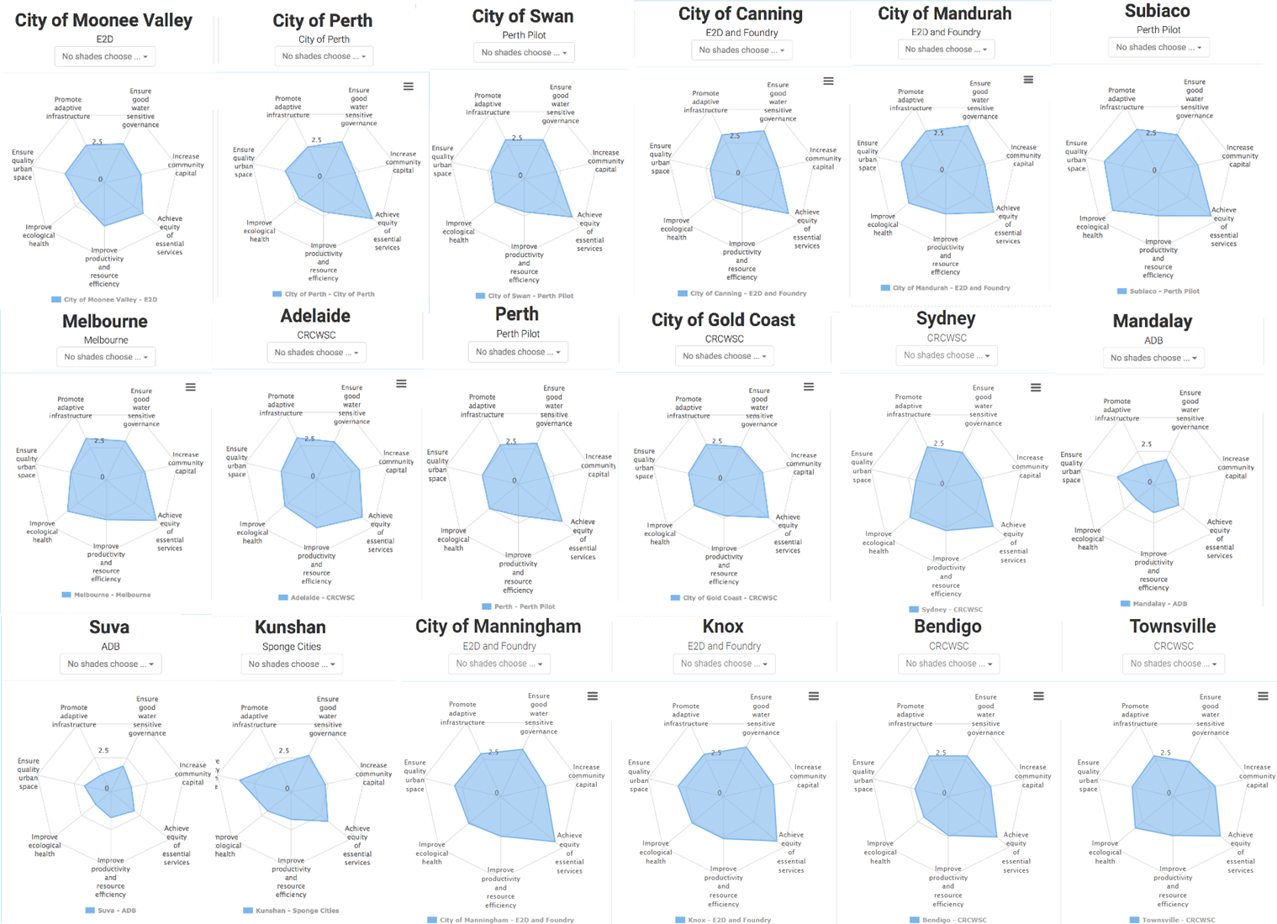

Slide 34
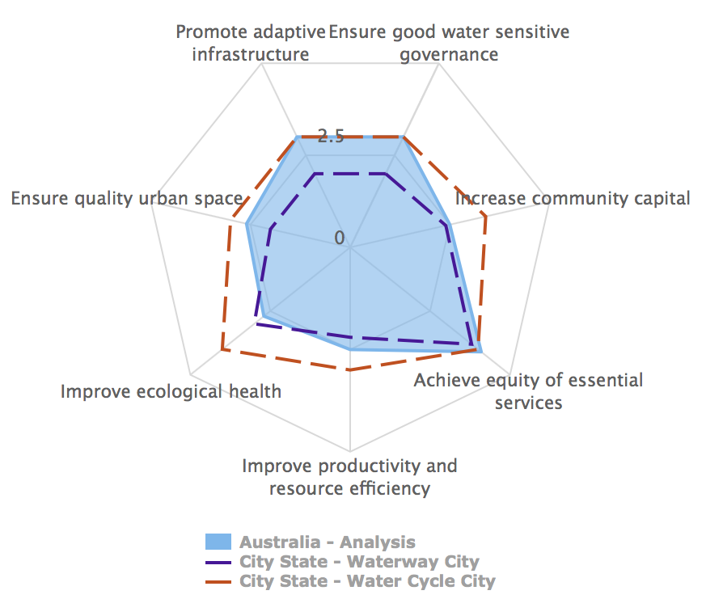
The average of Australian cities

Slide 35
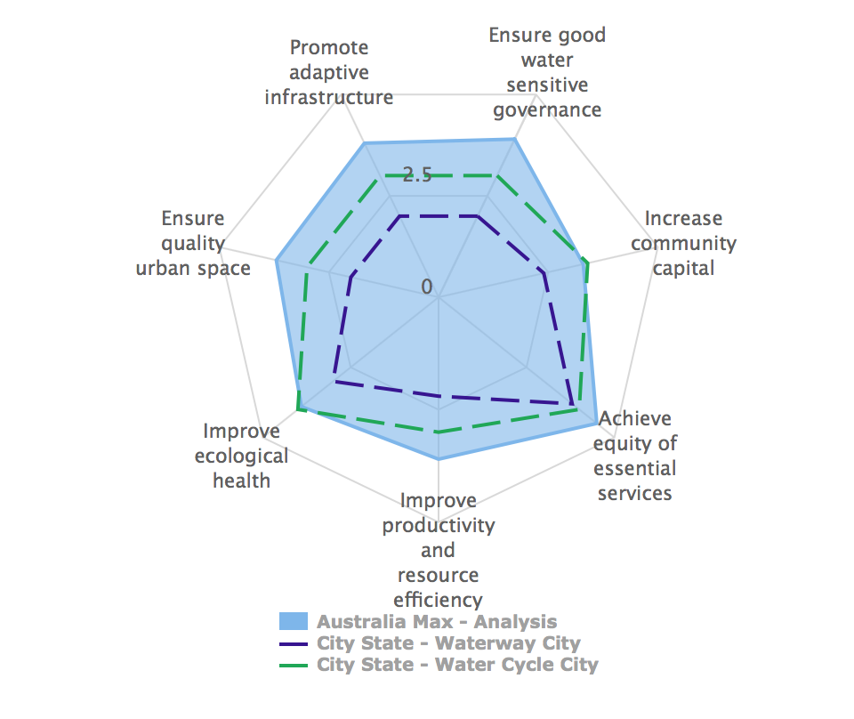
The best of Australian cities

Slide 36
Results of <insert city name>

Slide 37
Add bar graph here

Slide 38
Indicator scores
Notes:
May like to talk through the indicator scores, anything extraordinary, a little comparison between other cities...Use the 'City comparison' documents to compare, and for open discussion.

Slide 39
https://www.surveymonkey.com/r/wsc-i-survey
Please complete the Index workshop survey
https://www.surveymonkey.com/r/wscisurvey
Notes:
Please ask participants to complete the Index workshop survey. Time has been allocated for participants to complete the survey just before the workshop concludes.

Slide 40
Thank you.

